Slide 1
WSN@work the controller Peter Van Aken

Slide 2
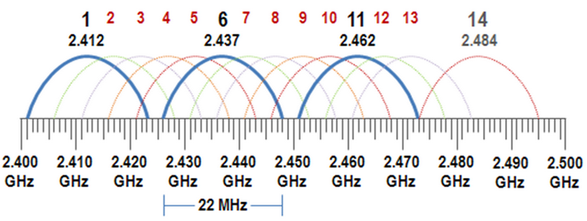

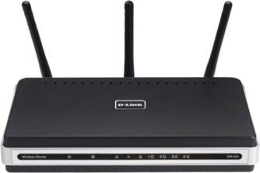
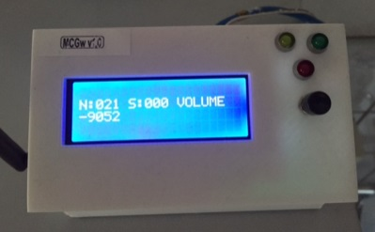
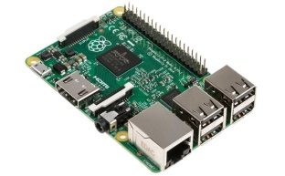


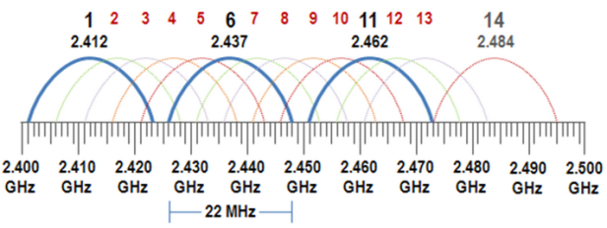
WSN@Work topology
Wifi : auto channel
http(s)://192.168.0.107
Open SSID : WSNatWork
(192.168.0.1)
LAN
192.168.0.x
(192.168.0.225)
(192.168.0.107)
MQTT client Gateway
Controller
Wireless Sensor Network
Sensor / Actuator node
Repeater node
selfhealing
meshing
w/battery powered
ISM (Industrial Scientific Medical) license-free band
Channel 76
(2.476Ghz)
LED-nodes

Slide 3
Topics
Getting your Raspberry Pi 2 ready
Installing OpenHab
MQTT as bridge

Slide 4
Getting your RPiV2 ready
Info source : https://www.raspberrypi.org
Install methods :
NOOBS : OR
https://www.raspberrypi.org/help/noobs-setup/
Select your OS during PI startup
Native (Raspian) (my preference)
Workflow for both methods is the same :
Install an SD write on your OS (Linux/Mac/Windows)
Burn .img to SD
Boot Rpi with SD and configure
BACKUP : done with the same SD writer !! (keep a base image)

Slide 5
Getting your RPiV2 ready
“sudo raspi-config” is your best friend
1 : expand filesystem
5 : internationalisation options
I1 : nl_BE@euro ISO_8859_15
I2 : Europe/Brussel
I3 : keyboard (!! Default is QWERTY)
reboot
6 : enable camera (if available)
9 : advanced options
A4 : enable SSH
2 : change user passwd
reboot

Slide 6
Getting your RPiV2 ready
Network access :
Wired : woks out-of-the box
Wireless : https://www.raspberrypi.org/documentation/configuration/wireless/wireless-cli.md
SSH with root :
Set passwd : sudo passwd root
In /etc/ssh/sshd_config : search for “PermitRootLogin” and change this to “yes”
Now SSH access is working for both users
sudo apt-get update
sudo apt-get upgrade
READY to run headless : backup base image

Slide 7
Getting your RPiV2 ready : optional
VNC
sudo apt-get install tightvncserver
start once to set passwd
vncserver :1 –geometry 1920x1080 –depth 24
Automatic start during boot :
copy “vncstart” to /etc/init.d in your PI
sudo chmod +x /etc/init.d/vncstart
sudo update-rc.d vncstart defaults
OR : https://www.raspberrypi.org/documentation/remote-access/vnc/
This is my base image backup

Slide 8
Getting your RPiV2 ready : optional
Samba : http://raspberrywebserver.com/serveradmin/share-your-raspberry-pis-files-and-folders-across-a-network.html
Change hostname : http://raspberrywebserver.com/serveradmin/change-your-pis-host-name.html
Backup data to “the Cloud” : http://raspberrywebserver.com/serveradmin/back-up-your-pi-to-your-google-drive.html
Touchscreen keyboard :
sudo apt-get install matchbox
GVIM :
sudo apt-get install vim-gui-common

Slide 9
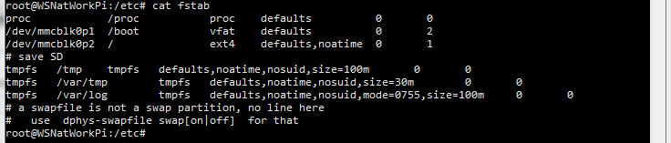
Getting your RPiV2 ready : optional
Extend SD card lifetime : http://www.zdnet.com/article/raspberry-pi-extending-the-life-of-the-sd-card/

Slide 10
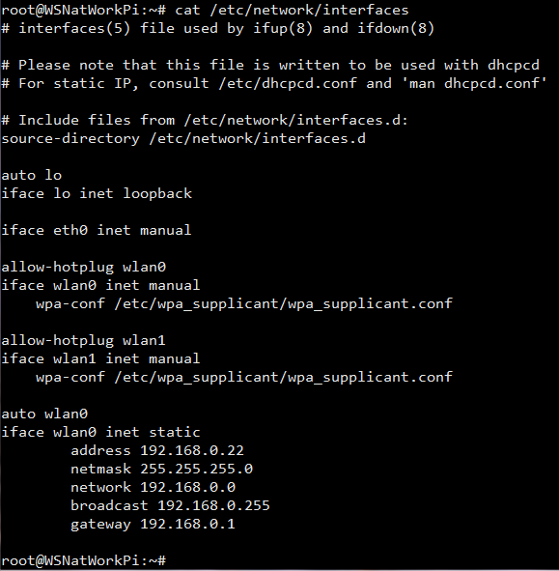
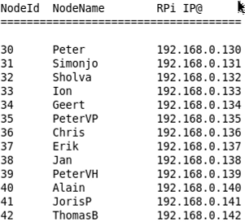
Static IP@ for the workshop
(100 + YOUR NodeID)
Add
(see NodeIdAllocation.txt)

Slide 11
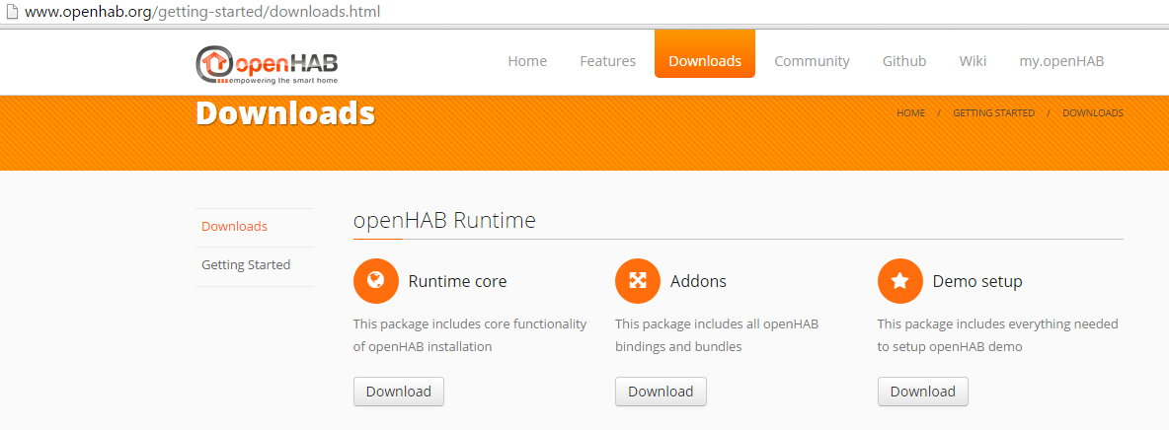

Installing Openhab
Info source : http://www.openhab.org/

Slide 12
Installing Openhab
Copy “Openhab 1.8.0” folder under /home/pi (ssh/...)
This folder includes :
demo
addons used in WSN. Add from “Openhab 1.8.0 Addons” depending upon your need. Startup-time !
In /home/pi/Openhab 1.8.0 : chmod 755 *.sh

Slide 13
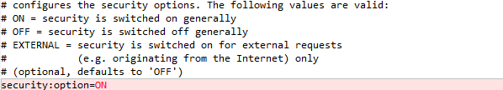

Configuring Openhab : security
/home/pi/Openhab 1.8.0/configuration/openhab.cfg
/home/pi/Openhab 1.8.0/configuration/users.cfg

Slide 14
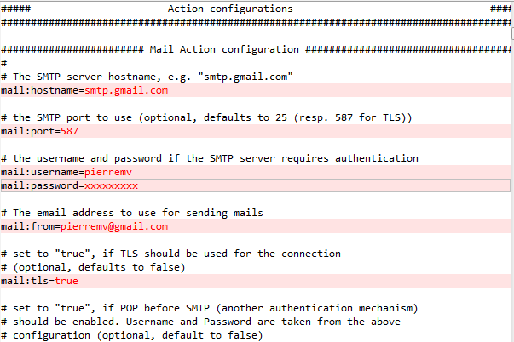
Configuring Openhab : SMTP
/home/pi/Openhab 1.8.0/configuration/openhab.cfg
...this will allow Openhab to send you emails based on rules...

Slide 15
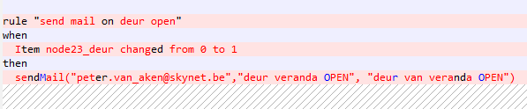
Configuring Openhab : SMTP
Example rule : no need to add for workshop

Slide 16
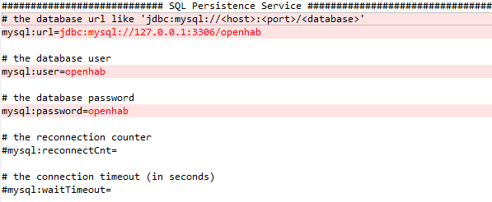
Configuring Openhab : MySQL
/home/pi/Openhab 1.8.0/configuration/openhab.cfg
this will allow Openhab to store sensor data
MySQL can be running remotely or on NAS device. In this example it’s local in RPi

Slide 17
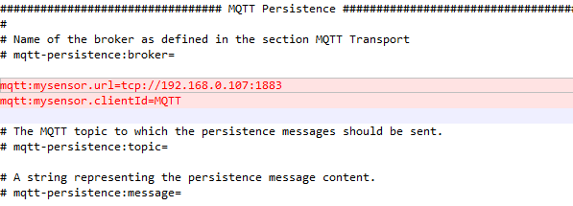
Configuring Openhab : MQTT
/home/pi/Openhab 1.8.0/configuration/openhab.cfg
Point to the location were your MQTT broker (e.g. Mosquitto) is running. This must be synced with the gateway.
For WSNatWork workshop : stick to this IP@
...these are the basic to get WSNatWork up and running but there is much, much more inside...

Slide 18
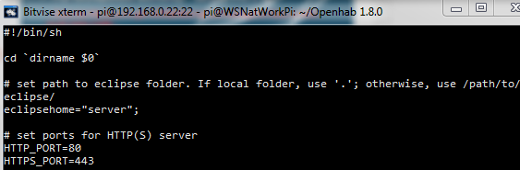
Configuring Openhab : port
/home/pi/Openhab 1.8.0/start.sh
sudo vi start.sh (same for start_debug.sh)

Slide 19
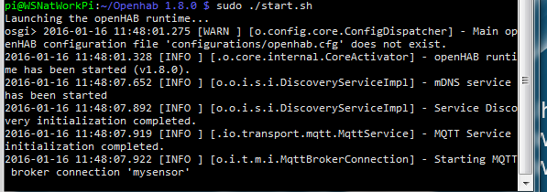
Start Openhab
In /home/pi/Openhab 1.8.0/configuration/
Without debug : sudo ./start.sh
With debug : sudo ./start_debug.sh

Slide 20
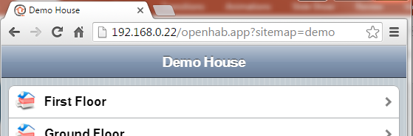
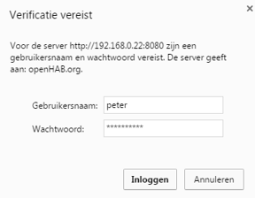
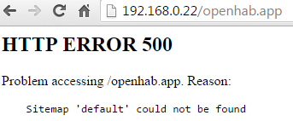
Connect to Openhab

Slide 21

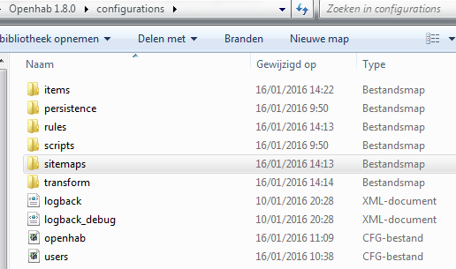
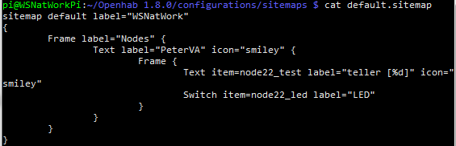
Moving your LED-node into Openhab

Slide 22
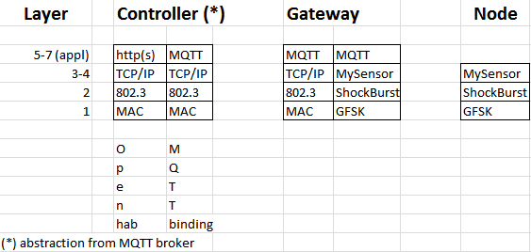
Internals : e2e WSNatWork stack
Wired/ Wireless
RF

Slide 23

Internals : MQTT broker
WSNatWork is using Mosquitto 3.1.1. (free open source SW)
About MQTT :

Slide 24
Internals : MQTT broker
Basic concept in a nutshell :
works with topics (MyMQTT/22/1/V_VOLUME...)
MQTT clients subscribe to interesed topics in MQTT broker
MQTT clients publish topics to MQTT broker
MQTT broker publishes topics to subscribed MQTT clients (kind of multicast)
Very good explanation : http://www.hivemq.com/blog/mqtt-essentials/ (part 1 – 11)
MQTT Client
MQTT Broker
MQTT Client

Slide 25
MQTT broker / live capture using wireshark
Openhab (see your IP@)
MQTT broker
(192.168.0.107)
Gateway
(LED) node
connect
publish
see air capture workshop 1.1
publish
publish

Slide 26
Optional

Slide 27
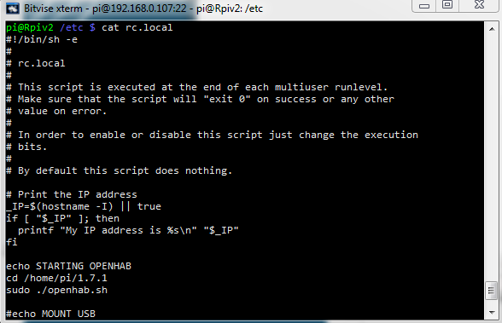
Openhab @ startup

Slide 28
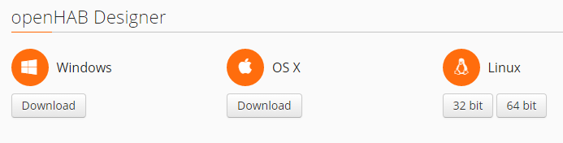
Habmin
Already included :
http:<your Openhab ip>/habmin
Alternative :

Slide 29
MySQL
- install : sudo apt-get install mysql-server
add openhab user: mysql –u root –p
create database openhab;
CREATE USER 'openhab'@'localhost' IDENTIFIED BY 'openhab';
GRANT ALL PRIVILEGES ON openhab.* TO 'openhab'@'localhost';
tips :
- Drop database : drop database if exists openhab;
- Select database : use openhab;
- Show tables : show tables;
- Create database : create database openhab;

Slide 30
Wireshark & MQTT
see :
https://github.com/menudoproblema/Wireshark-MQTT
start :
wireshark -X lua_script:mqtt.lua
capture :
mqtt.publish.topic matches "MyMQTT/69/6"
prefix
nodeId
sensor

Slide 31
MQTT broker : Mosquitto
Install :

